Slide 1
Invasive Species

Slide 2
Objectives
By the end of this section, you should be able to:
Discuss why it is important to consider invasive species for systematic conservation planning
List the major assumptions that are often violated when modeling invasive species and how this may impact results
Discuss the modeling approaches to predict a species invasion
Explain how SDMs can be used to predict invasive species’ response to climate change

Slide 3
Invasive Species and Systematic Conservation Planning
Separate biodiversity from processes that threaten persistence
“…Mapping patterns and monitoring rates of spread of threats to biodiversity…” (Margules and Pressey, 2000)
Need to target proximate drivers of decline
Early detection and rapid response → lower management cost

Slide 4
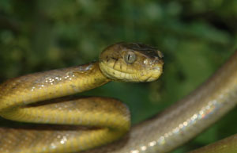
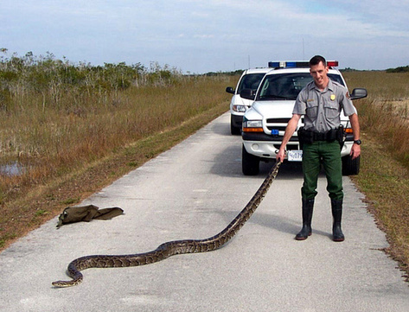
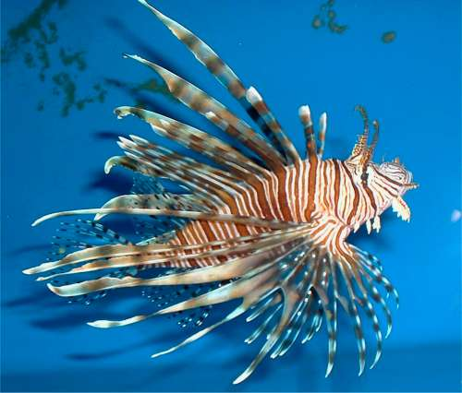
Invasive Species and Systematic Conservation Planning
Mechanisms
Environmental change
Climate change
Natural or anthropogenic modifications
Human transport
Accidental
Intentional
Brown tree snake
Burmese python
Lionfish

Slide 5
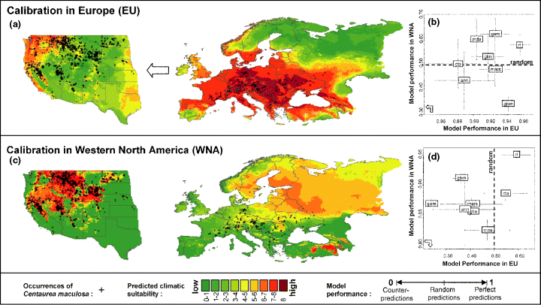
Invasive Species and SDM assumptions
Violations
Equilibrium
Training data are representative of the conditions to which the models are projected
Niche conservation
Conundrum
Invasive species pose one of the greatest need for prediction of potential distribution, but often have the greatest assumption violations
Ecology Letters Volume 10, Issue 8, pages 701-709, 11 JUN 2007 DOI: 10.1111/j.1461-0248.2007.01060.x http://onlinelibrary.wiley.com/doi/10.1111/j.1461-0248.2007.01060.x/full#f2

Slide 6
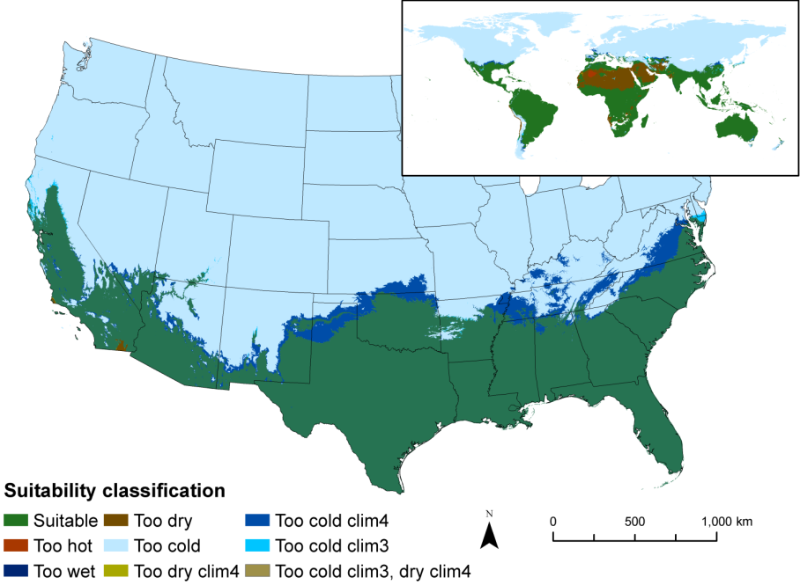
Python : cautionary example
Precipitation and Temperature
Matched to 149 data points

Slide 7
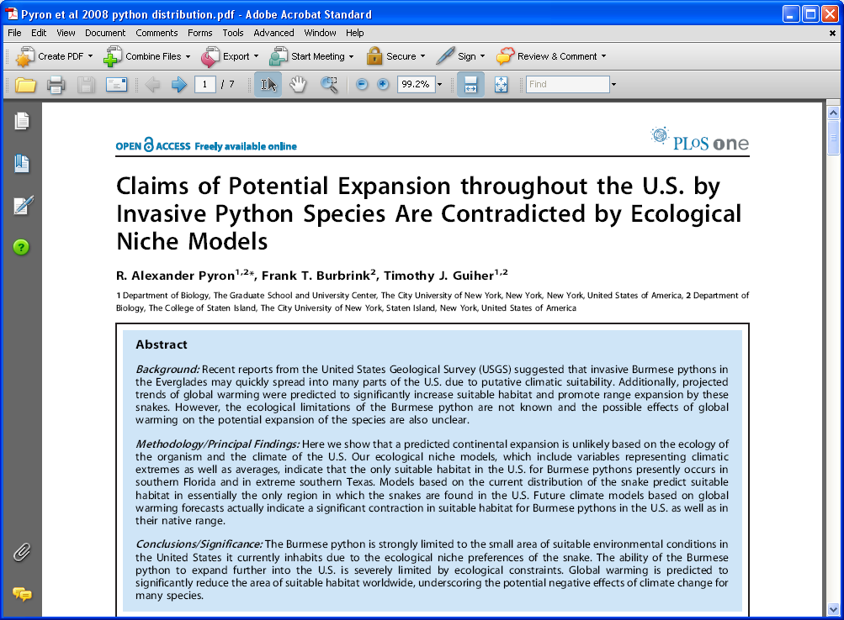
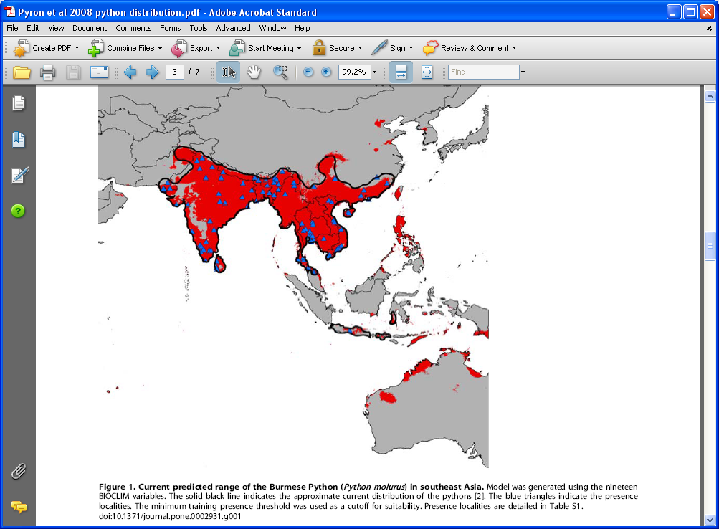
Response: Niche model
Museum locations
19 bioclimatic variables
Pyron, R. A., F. T. Burbrink, and T. J. Guiher. 2008. Claims of potential expansion throughout the U.S. by invasive python species are contradicted by ecological niche models. PloS ONE 3:1 - 7.

Slide 8
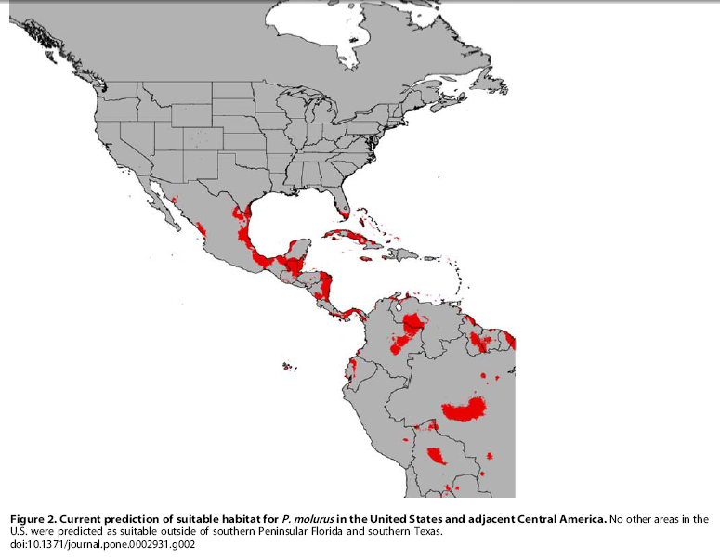
Maxent Model
Much less habitat in US
Concerns:
Background points from globe
Four localities for different species
Overfit model – patchiness

Slide 9
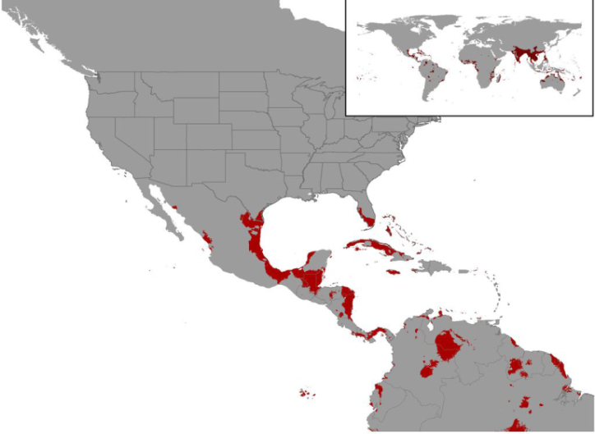
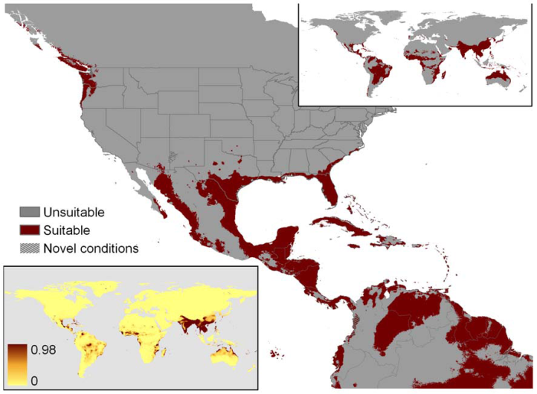
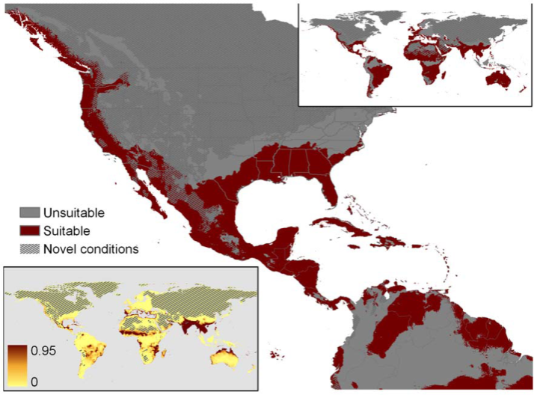
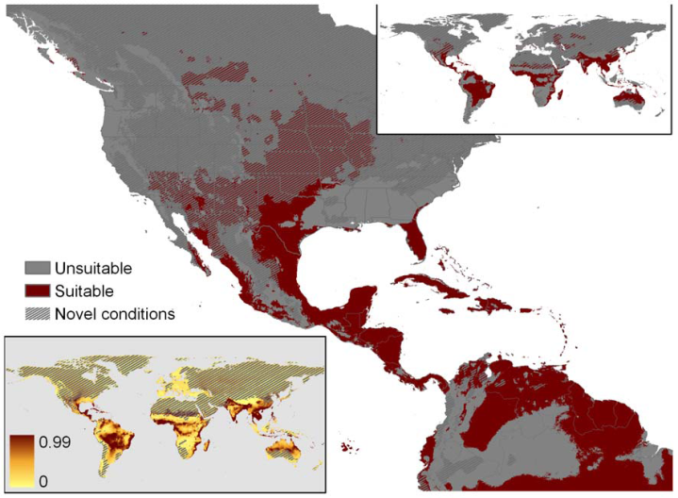
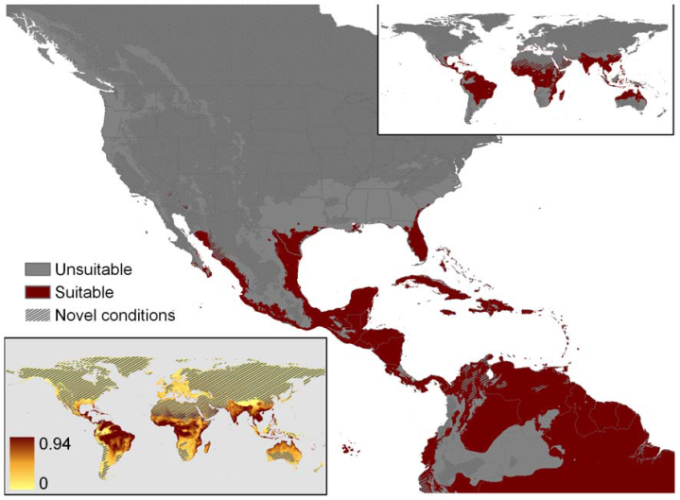
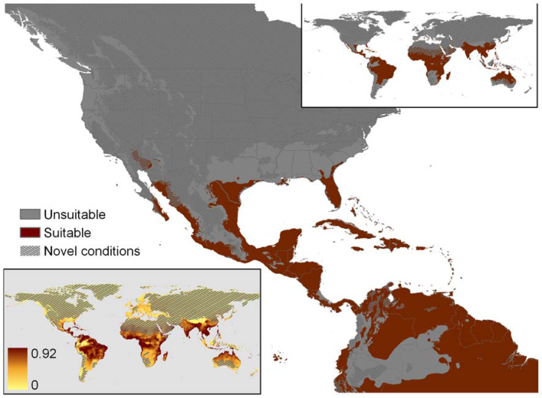
Caution of the defaults
Overfit-global-90
Overfit-global-86
Overfit–regional absence -86
Overfit-MCP-86
AICc-MCP-90
AICc-MCP-86

Slide 10
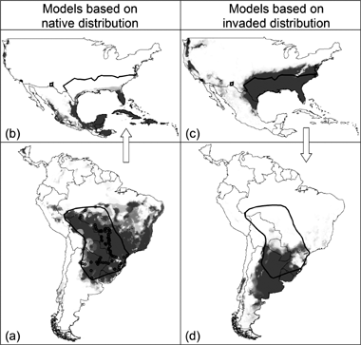
How invasive species models are constructed
Develop model on native range apply to invaded range
Develop model within invaded range
Absences and background
Emphasize general or smooth response curves
Integrate correlative and mechanistic models
Use both native and invaded range data
Global Ecology and Biogeography Volume 16, Issue 1, pages 24-33, 15 DEC 2006 DOI: 10.1111/j.1466-8238.2006.00258.x http://onlinelibrary.wiley.com/doi/10.1111/j.1466-8238.2006.00258.x/full#f1

Slide 11
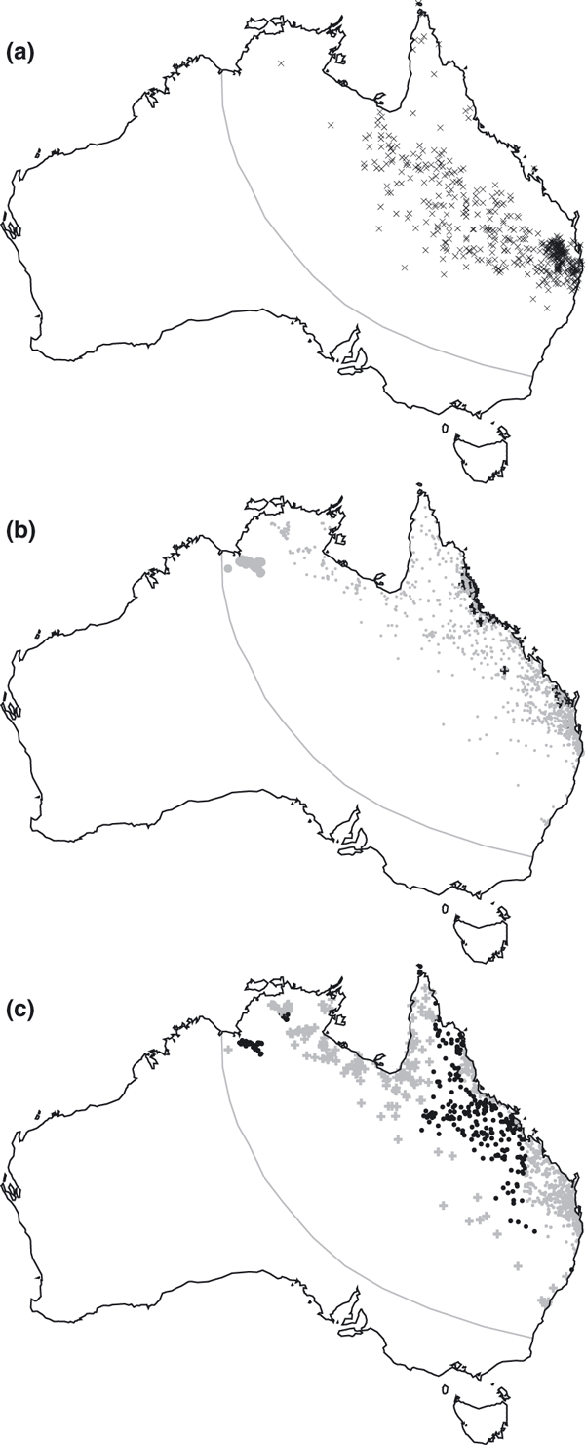
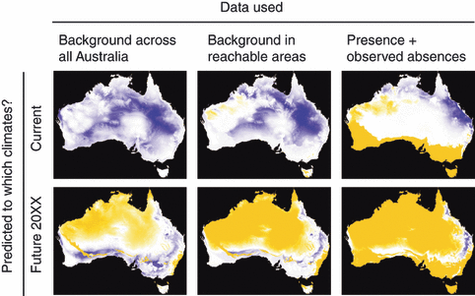
Ecologically meaningful variables
Removed highly correlated variables (>0.85)
Used four methods of evaluation
1)Performance on known data
2)Variable importance, response curves and maps
3)MESS map (novel environments)
4)compare predictions to a mechanistic model
Evaluate correlation structure between modeled area and projected area
Treatment of absence point most
important

Slide 12
Iterative Appraoch

Slide 13
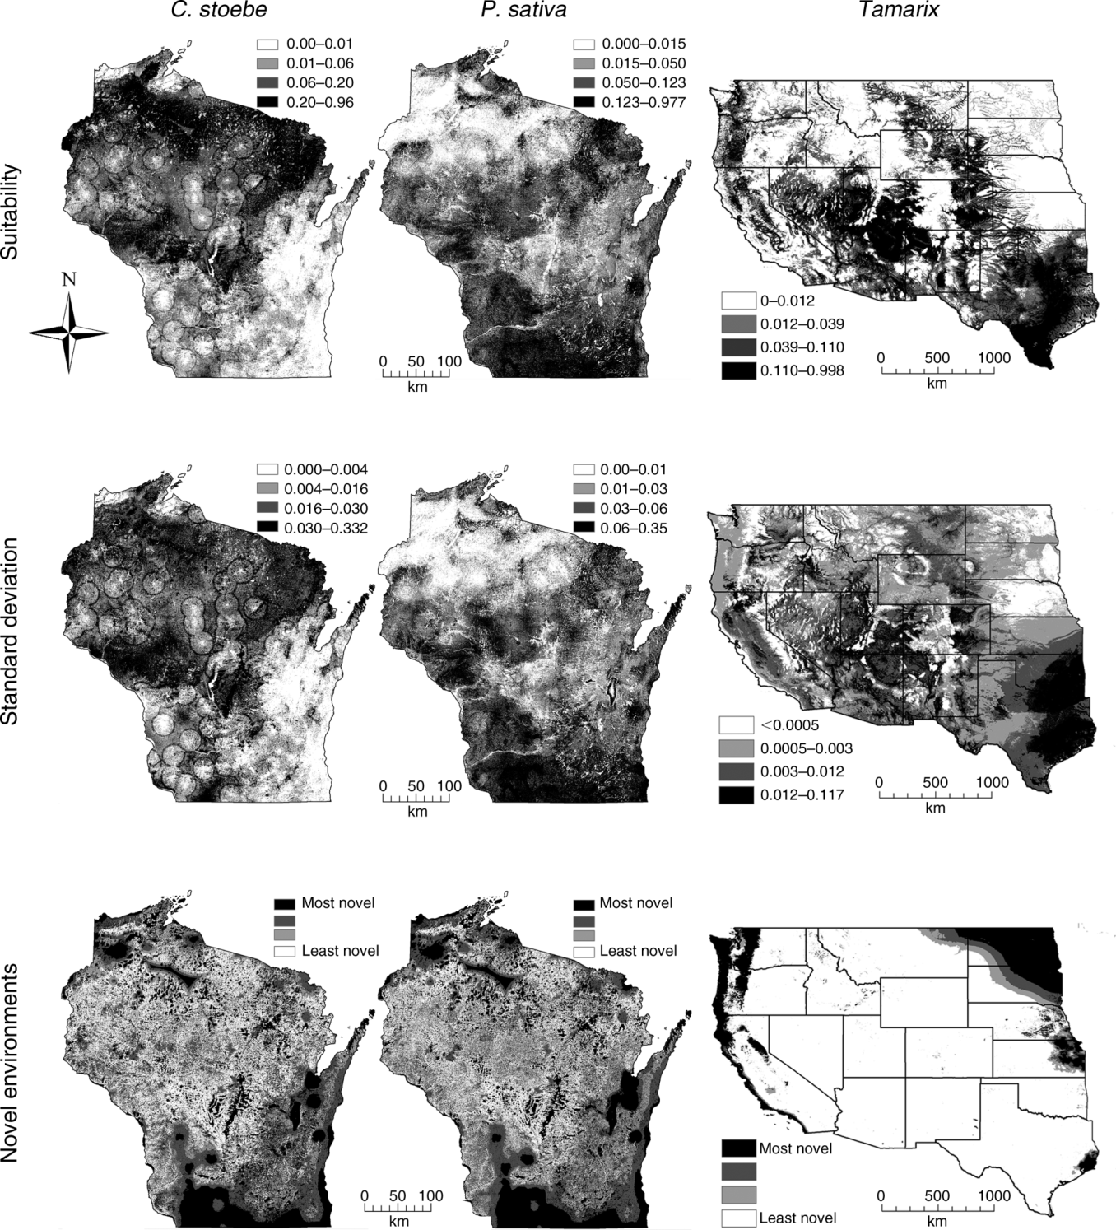
Crall, A. W., Jarnevich, C. S., Panke, B., Young, N., Renz, M., & Morisette, J. (2013). Using habitat suitability models to target invasive plant species surveys.Ecological Applications, 23(1), 60-72.

Slide 14
Refining predictions
Including biotic and dispersal limitations
Also used Iterative approach for targeted sampling (new invasion)
Meentemeyer, R. K., Anacker, B. L., Mark, W., & Rizzo, D. M. (2008). Early detection of emerging forest disease using dispersal estimation and ecological niche modeling. Ecological Applications, 18(2), 377-390.

Slide 15
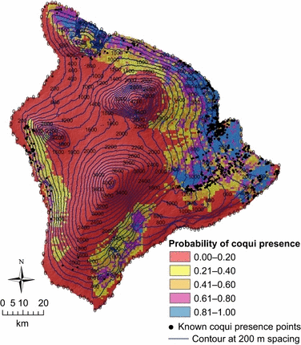
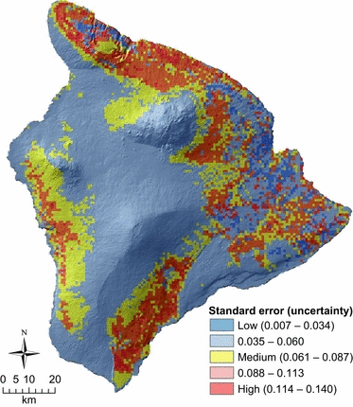
Addressing Uncertainty
Where are the areas of uncertainty?
Diversity and Distributions Volume 18, Issue 7, pages 648-660, 26 NOV 2011 DOI: 10.1111/j.1472-4642.2011.00867.x http://onlinelibrary.wiley.com/doi/10.1111/j.1472-4642.2011.00867.x/full#f4

Slide 16
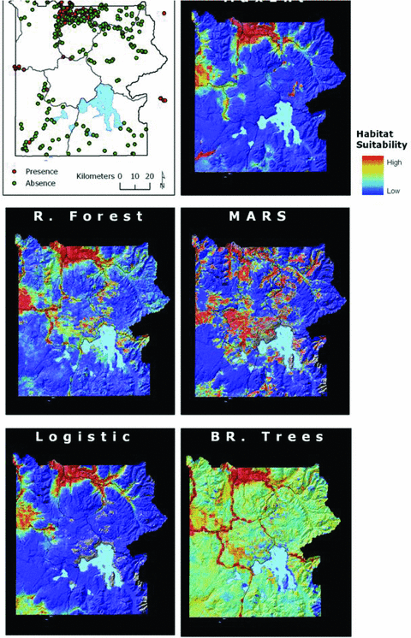
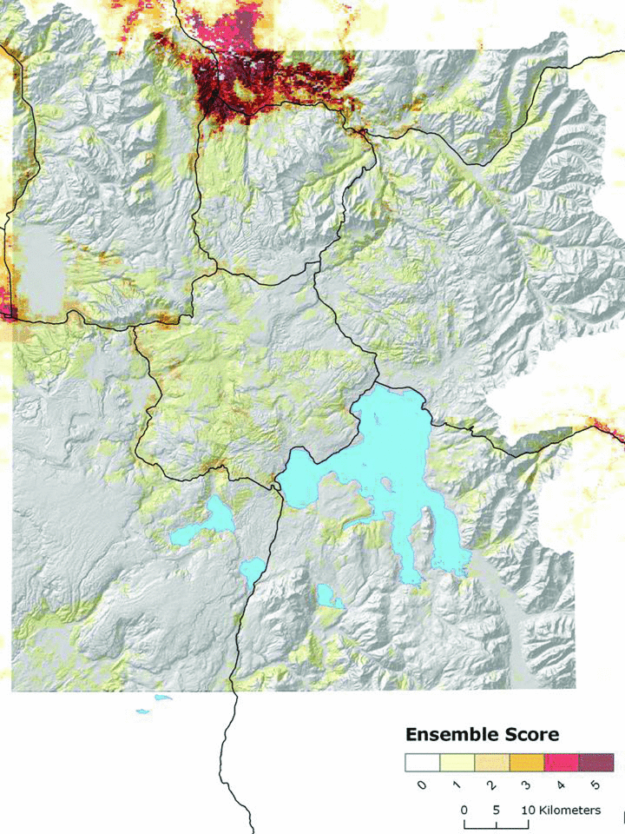
Addressing Uncertainty
Ensemble prediction
Risk Analysis Volume 30, Issue 2, pages 224-235, 2 FEB 2010 DOI: 10.1111/j.1539-6924.2009.01343.x http://onlinelibrary.wiley.com/doi/10.1111/j.1539-6924.2009.01343.x/full#f1

Slide 17
Take home
Mapping current and potential distributions of invasive species is challenging BUT important
Relatively new methods continue to improve
More transparency needed
Need many sources of model evaluation
Iterative approach
Emphasis on uncertainty

Slide 19
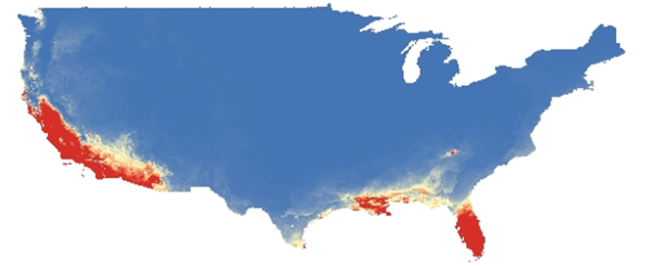
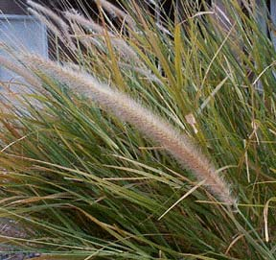
Mapping and Predicting Rates of Spread
Current
African Fountain Grass (Pennisetum setaceum)
2040

Slide 20
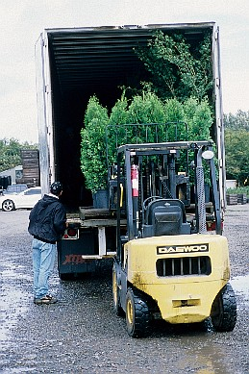
Mapping and Predicting Rates of Spread
+
Current
Truck = 500 km/day
vs.
Climate Change = 5 km/year
2040

