Slide 1
Maxent Overview
Modified from Catherine Jarnevich, Sunil Kumar, Paul Evangelista, Jeff Morisette, Tom Stohlgren

Slide 2
Objectives
By the end of this section, you should be able to:
Describe, broadly, Maxent modeling and some examples of its application
Give some examples of why you would and wold not use Maxent
State the assumptions and limitations of Maxent
Describe the inputs and outputs of Maxent
Articulate what the mapped predictions from Maxent mean
Evaluate model predictive performance
Ask the most important questions when handed a Maxent model

Slide 3
Why Maxent for this Workshop
Don’t have time for all methods
Heavily used in the literature and well known
Consistently performs as well or better than other methods in comparisons
One of the more approachable methods
Notes:
Google groups
Free Online

Slide 4
Background: The model
Maxent is a general purpose method that makes predictions from incomplete information
Machine learning method
Used in many fields
Generative approach
Estimates an unknown probability by finding the probability distribution of maximum entropy given some constraints
Notes:
Machine learning
-system that ‘learns’ from the empirical data
-No assumptions about data model
Fields: astronomy, image reconstruction, portfolio optimization and many other fields
Not discriminative (e.g., GLM/GAM)
i.e., most spread out or closest to uniform

Slide 5
Background: Specifically for SDM
Developed by Steven Phillips at AT&T Labs-Research
Many applications
Often termed ‘Presence-only’, but closer to resource availability
Provides a model of habitat suitability
Notes:
Also recently described as a GLM with a LASSO function
Over 1,000 applications published since 2006
(compare presence locations to available environment)

Slide 6
Why Use Maxent
Best suited for exploratory or opportunistically collected data
Presence only data
Maximize the utility of publically available museum and herbaria data
Small number of occurrences
Poor or absent information on sampling methods
Not confident in absences
Continually performs well in comparison with other methods
Notes:
E.g., invasive species

Slide 7
Reasons to Not Use Maxent
No amount of statistical modeling can compensate for poor definition of the problem (Austin, 2002)
Have robust sampling method with confidence presence and absence data
Somewhat of a black box compared to other methods
Statistics are still new and underdeveloped
?
Notes:
Evaluation metrics are lacking

Slide 8
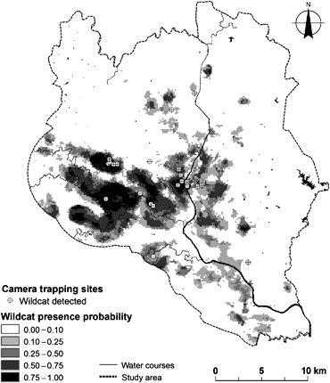
Applications
Find correlates to species distributions
What might be important drivers to a species distribution
Journal of Zoology Volume 279, Issue 1, pages 27-35, 13 MAY 2009 DOI: 10.1111/j.1469-7998.2009.00585.x http://onlinelibrary.wiley.com/doi/10.1111/j.1469-7998.2009.00585.x/full#f2
Notes:
Correlation does not mean causation
Monterroso et al. 2009
Spatial ecology of the European wildcat in a Mediterranean ecosystem: dealing with small radio-tracking datasets in species conservation

Slide 9
Applications
Map/predict current distributions
Conservation area delineation
Identify new, undocumented populations
New populations of endangered species
Identify population for early detection and rapid response
Heikkinen et al. 2007
Notes:
Invasive species

Slide 10
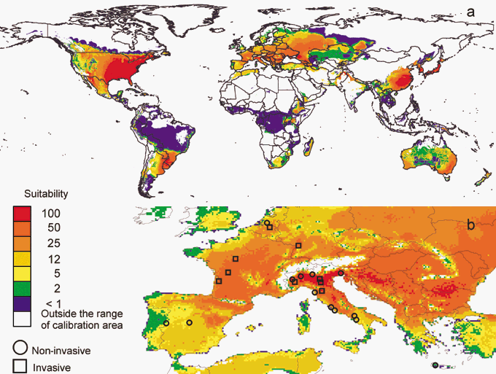
Applications
Predict to new time or locations
Evaluate how projected changes in climate will impact distributions
Identify the potential distribution of an invasive species
Diversity and Distributions Volume 13, Issue 4, pages 476-485, 1 JUN 2007 DOI: 10.1111/j.1472-4642.2007.00377.x http://onlinelibrary.wiley.com/doi/10.1111/j.1472-4642.2007.00377.x/full#f3
Notes:
Prediction and validation of the potential global distribution of a problematic alien invasive species — the American bullfrog

Slide 11
Assumptions and Limitations
Individuals have been sampled randomly across landscape
Sampling unit of size equal to the grain size of available environmental data
Notes:
samples occur in proportion to population density
This is the same for all SDM

Slide 12
Assumptions and Limitations
Environmental variables represent all factors that constrain the geographical distribution of the species
Species is in equilibrium with its environment
Background locations are representative of the available environment and address bias
Notes:
Background locations also need to account for any bias

Slide 13
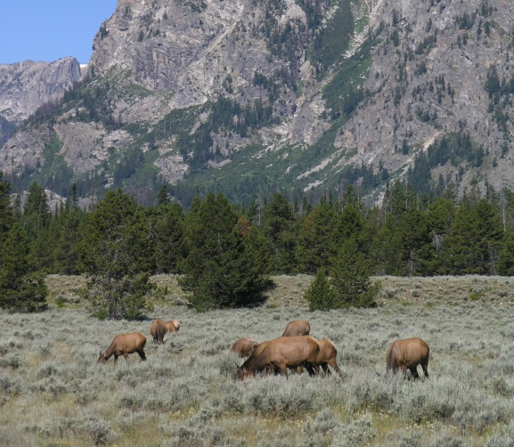
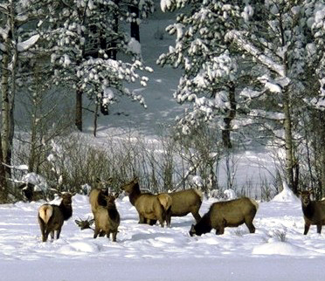
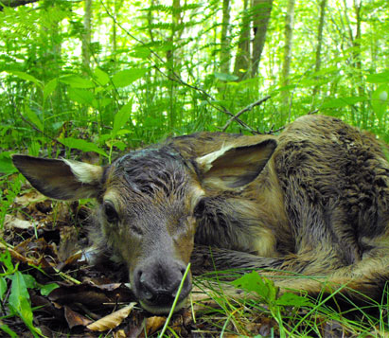
Assumptions and Limitations
Occurrences represent the intended response of interest
Notes:
Winter feed ground vs summer feeding ground vs calving area
Sink population versus source population

Slide 14
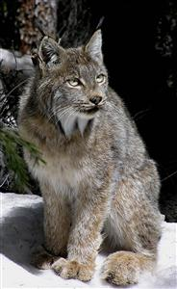
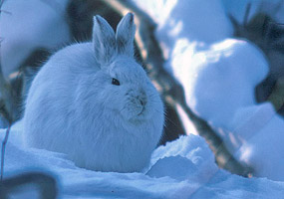
Assumptions and Limitations
Limitations
Cannot estimate prevalence with presence-only
Two species can have
Same range
Same distribution of occurrences
Ones is rarer
Sample selection bias (more on this later)
Background locations are treated as pseudo-absences for model evaluation
CPAW
NPS
Notes:
Can’t estimate prevalence with PO along - Same can be true for presence/absence due to detection probability. Need some measure of prevalence
Rarer (i.e., lower prevalence) Ex. predator and specific prey
Can change the average prevalence value in Maxent
Stronger effect on presence only models than presence/absence

Slide 15
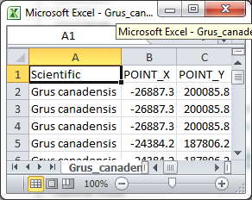
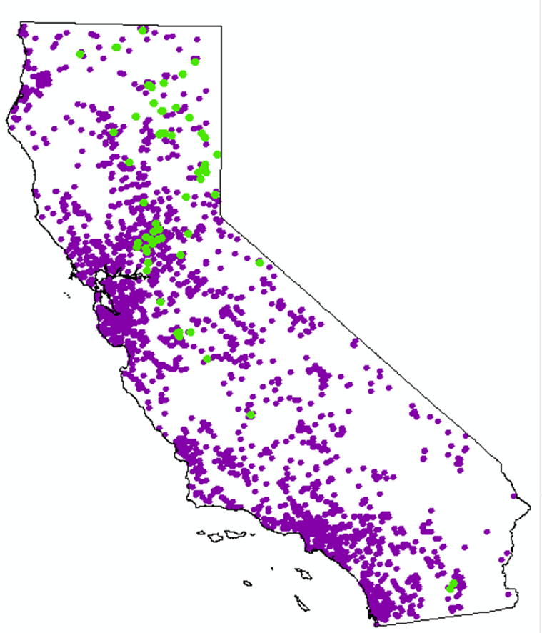
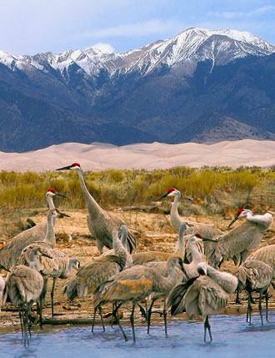
The inputs
Presence locations
Background locations
Random or user provided
Environmental information (for presence and background)
Notes:
Background locations: Need to include areas that are accessible via dispersal (i.e., species is likely to reach)
Environmental information can be generated within Maxent with ASCII grids as the input for the environmental data or they can be supplied by the user using the samples with Data (SWD) format.

Slide 16
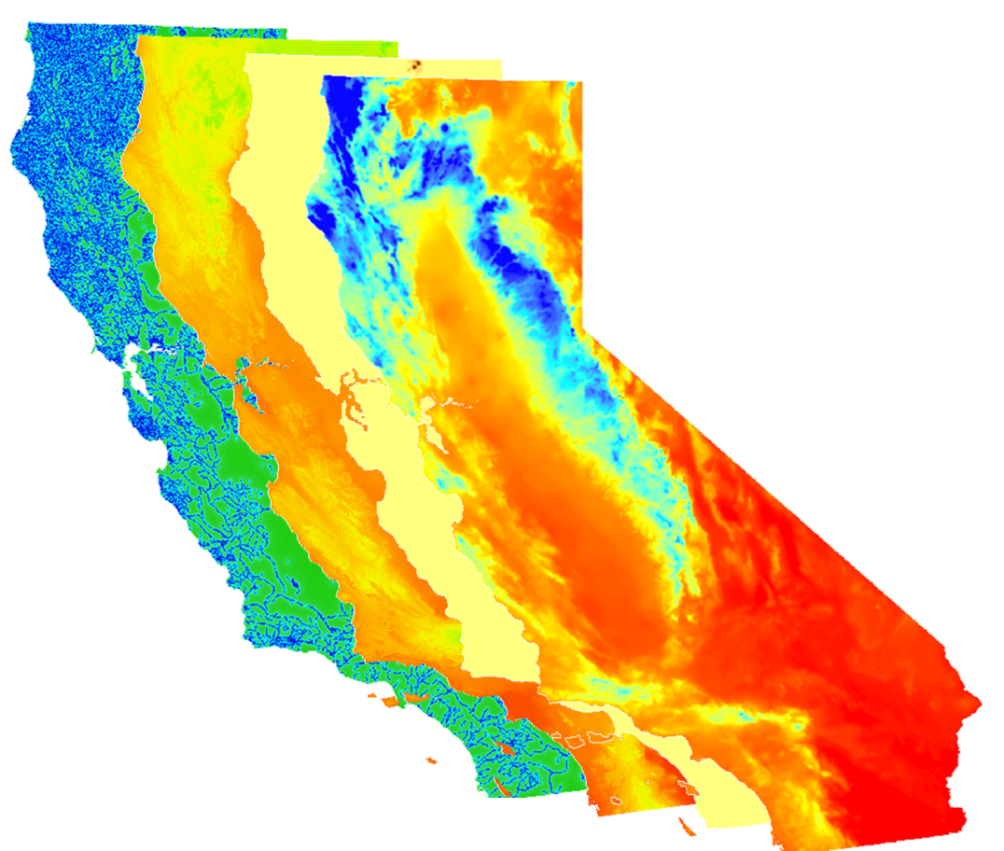
The inputs
ASCII grids of area of interest (optional)
Sampling effort (optional)
Test points (optional)
Projection ASCII grids (optional)
Notes:
To create maps, need ASCII grids

Slide 17
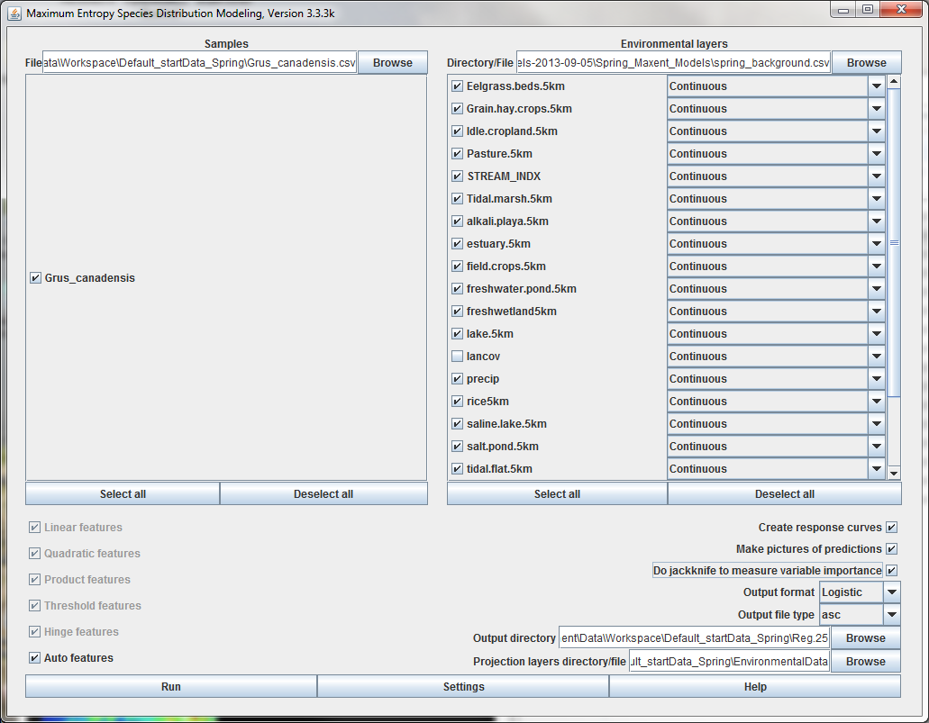
Maxent Graphical User Interface

Slide 18
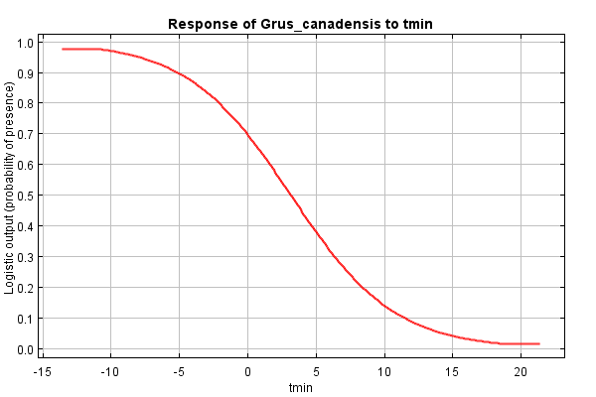
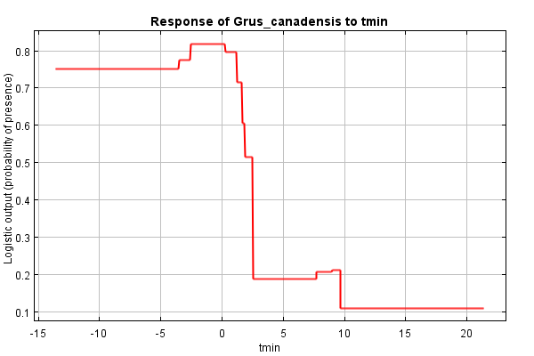
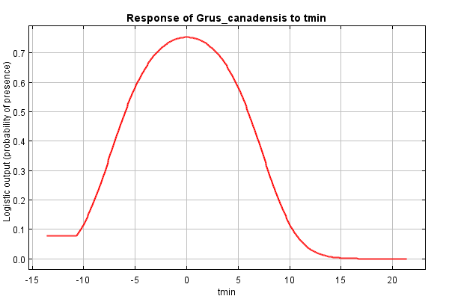
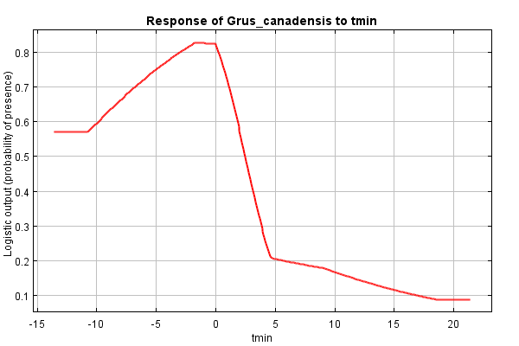
Features
Linear
Quadratic
Product
Threshold
Hinge
Categorical
Product of two variables (X1*X2)
Binary classification
Notes:
Hinge is similar to GAM – piecewise linear function

Slide 19
Settings
Features
Sample size | Feature type
> 80 | All
15 – 79 | Linear, quadratic, hinge
10 – 14 | Linear, quadratic
< 10 | Linear

Slide 20
Settings
Output format
Logistic
0-1 values
Most common – Index of habitat suitability
Raw
Relative occurrence rate
Cumulative
Sum of all raw values less than or equal to the raw value at that location scaled to be between 0 -100
Notes:
Cumulative output:
if we resample pixels according to the modeled Maxent probability distribution, then t% of the resampled pixels will have cumulative value of t or less
Probability of suitable habitat given the species is present and average prevalence

Slide 21
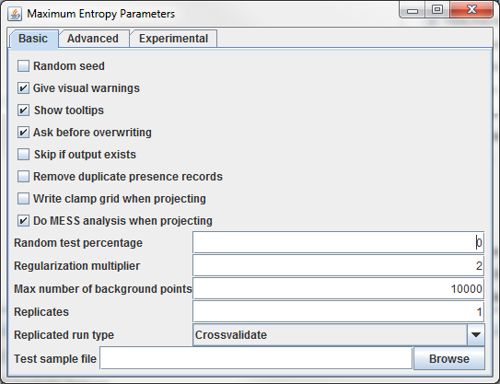
Settings
MESS analysis
Testing
Regularization
Replicates
Notes:
Subsample: split by percent, from entire set each time
Bootstrap: training size = number presence points, so duplication
Crossvalidate: divide into n equal parts, where n is the number of replicates

Slide 22
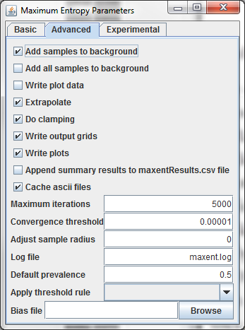
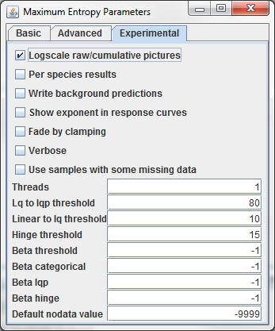
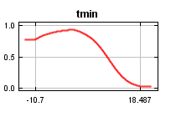
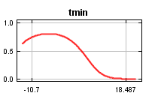
More Settings
Extrapolate
Clamping
Bias file
Clamping on
Clamping off
Notes:
Bias file - Relative survey effort

Slide 23
Outputs
Html file
modelResults.csv
AUC evaluation
Many different threshold values
Variable importance
Continuous probability prediction map
.asc file with no projection defined
MESS map (more on this later)

Slide 24
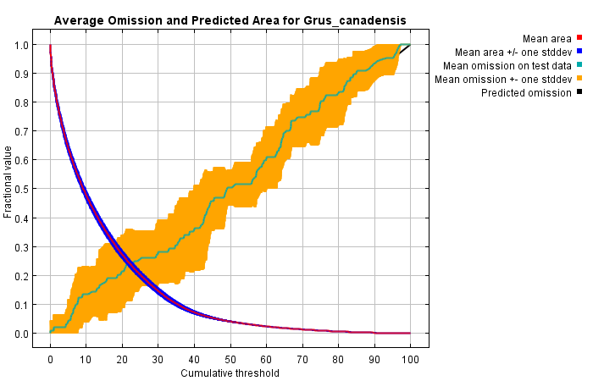
Omission rate
Comission
Type I error rate = False positive = null is true = crying wolf with no wolf
Omission
Type II = False Negative = alternative is true = Failing to raise alarm when there is a wolf
Notes:
Can’t do false positive with presence only
If Green and Blue lines are closer- High spatial autocorrelation between Training and Test data

Slide 25
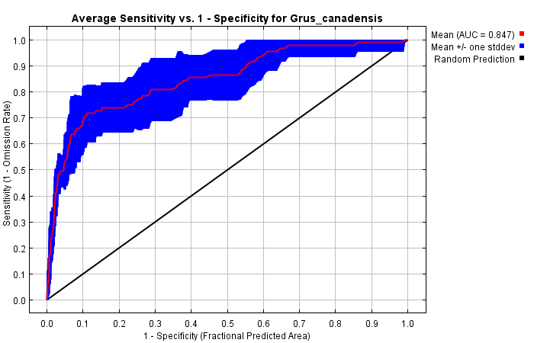
Receiver-operating characteristic (ROC)
Area Under the Curve (AUC)
Sensitivity
True positive rate (% of correctly classified positives)
Specificity
True negative rate (% of correctly classified negatives)
Range 0 – 1
True Positive Rate
False Positive Rate

Slide 26
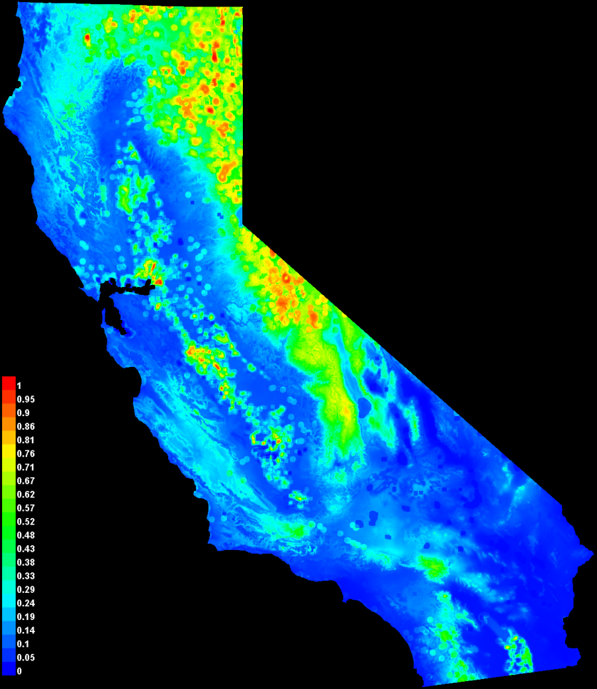
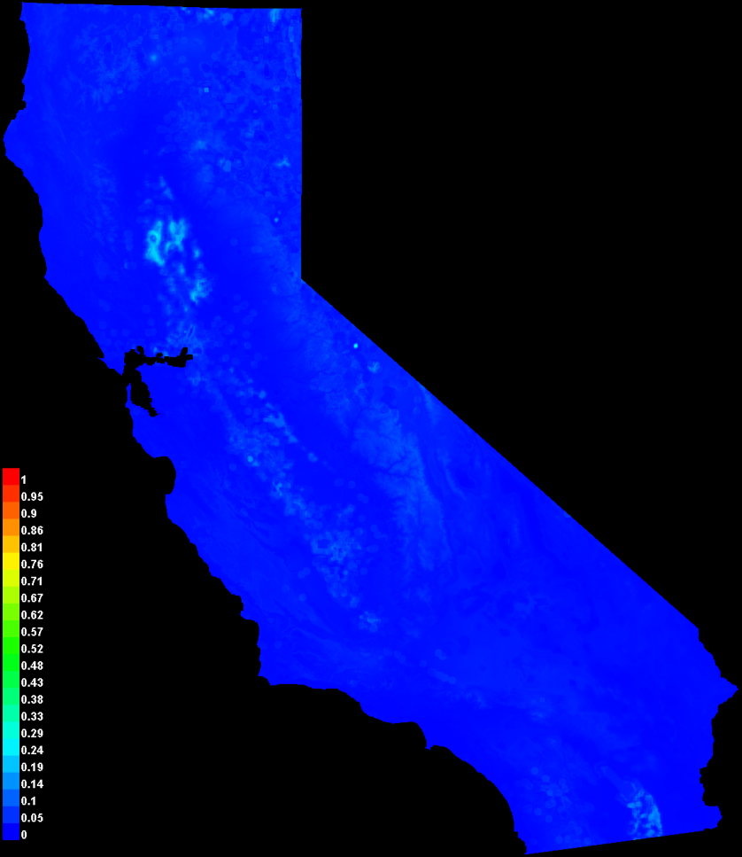
Picture of Predicted Model
Logistic mean map
Standard deviation
Notes:
Predictions among model iterations varied – one measure of uncertainty

Slide 27
Thresholds

Slide 28
Freeman, E. A., & Moisen, G. G. (2008). A comparison of the performance of threshold criteria for binary classification in terms of predicted prevalence and kappa. Ecological Modelling, 217(1), 48-58.

Slide 29
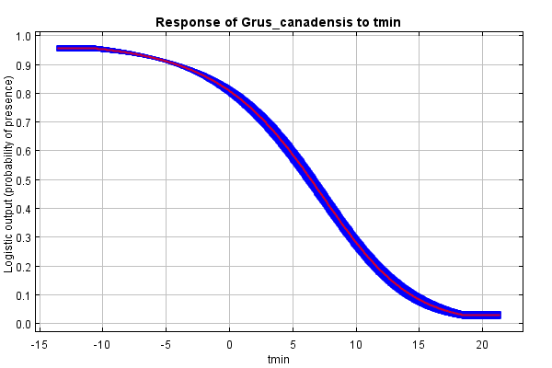
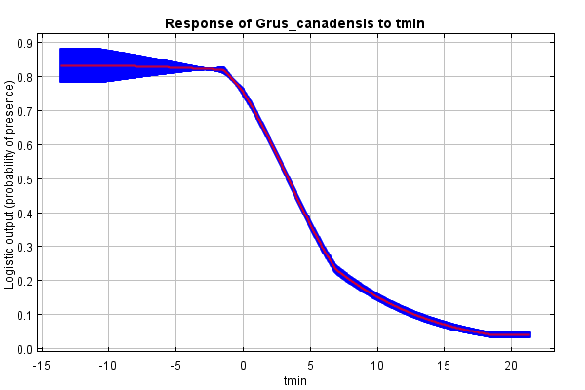
Response Curves
Two types
Variable is varied while all other variables held at the mean – look at changes in logistic prediction
Model is run with only one variable – better for interpretations if there are correlations
Notes:
Hard to interpret if there are strong correlations

Slide 30
Variable Contributions
Percent contribution
Calculated during model development from changes in the gain
Permutation importance
Each variable's values are changed at the training and background locations and the model re-evaluated
Large change in metrics = high contribution in model

Slide 31
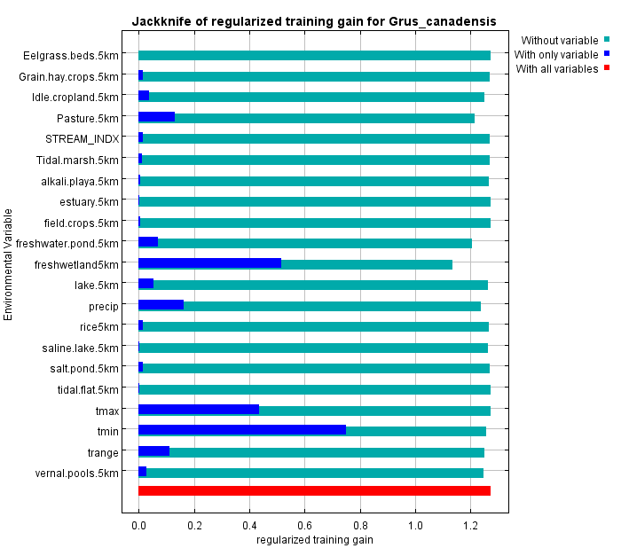
Jackknife
How variables contribute to model performance
Notes:
Tmin example

Slide 32
Model documentation

Slide 33
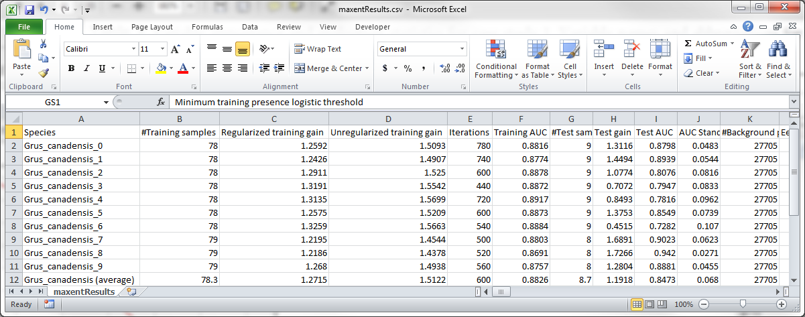
Results csv
Contains much of the information displayed in the html file

Slide 34
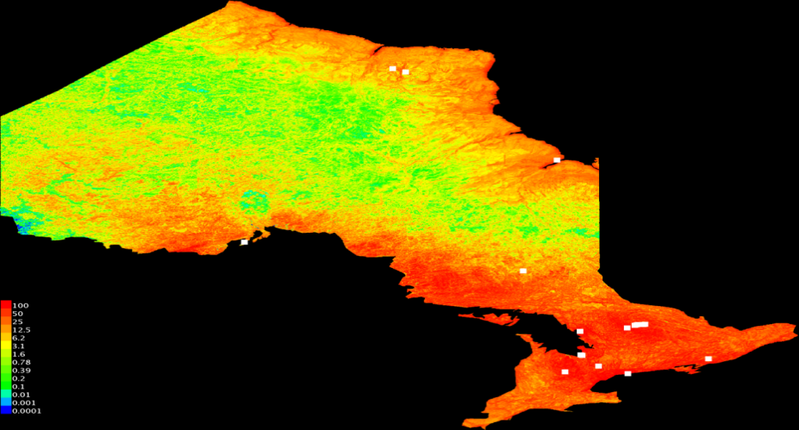
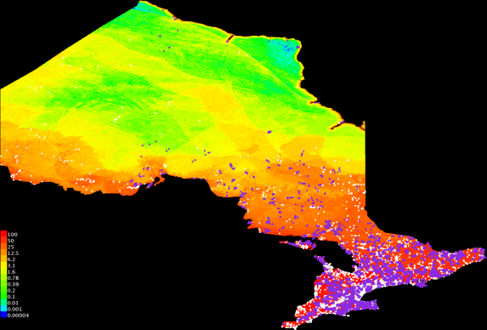
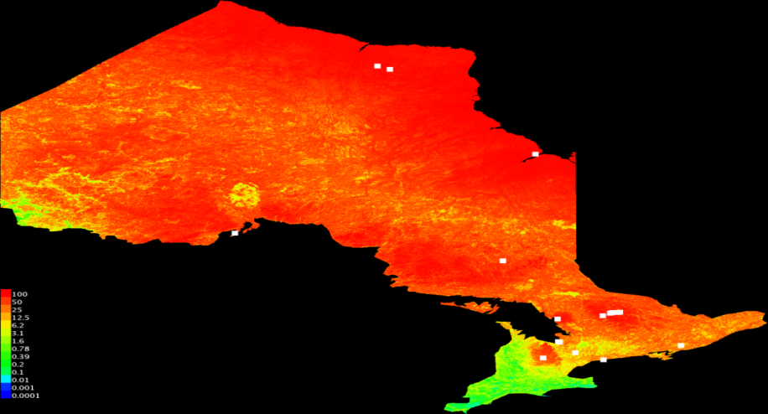
Target background – accounting for bias
Sensitive to sampling bias
Same bias in background→ cancels out
Random background
Phillips et al, 2009, Ecological Applications 19:181-197.
Sampling
effort
Targeted background
Notes:
likely that an entire target group of species observed
by similar methods will share similar bias

Slide 36
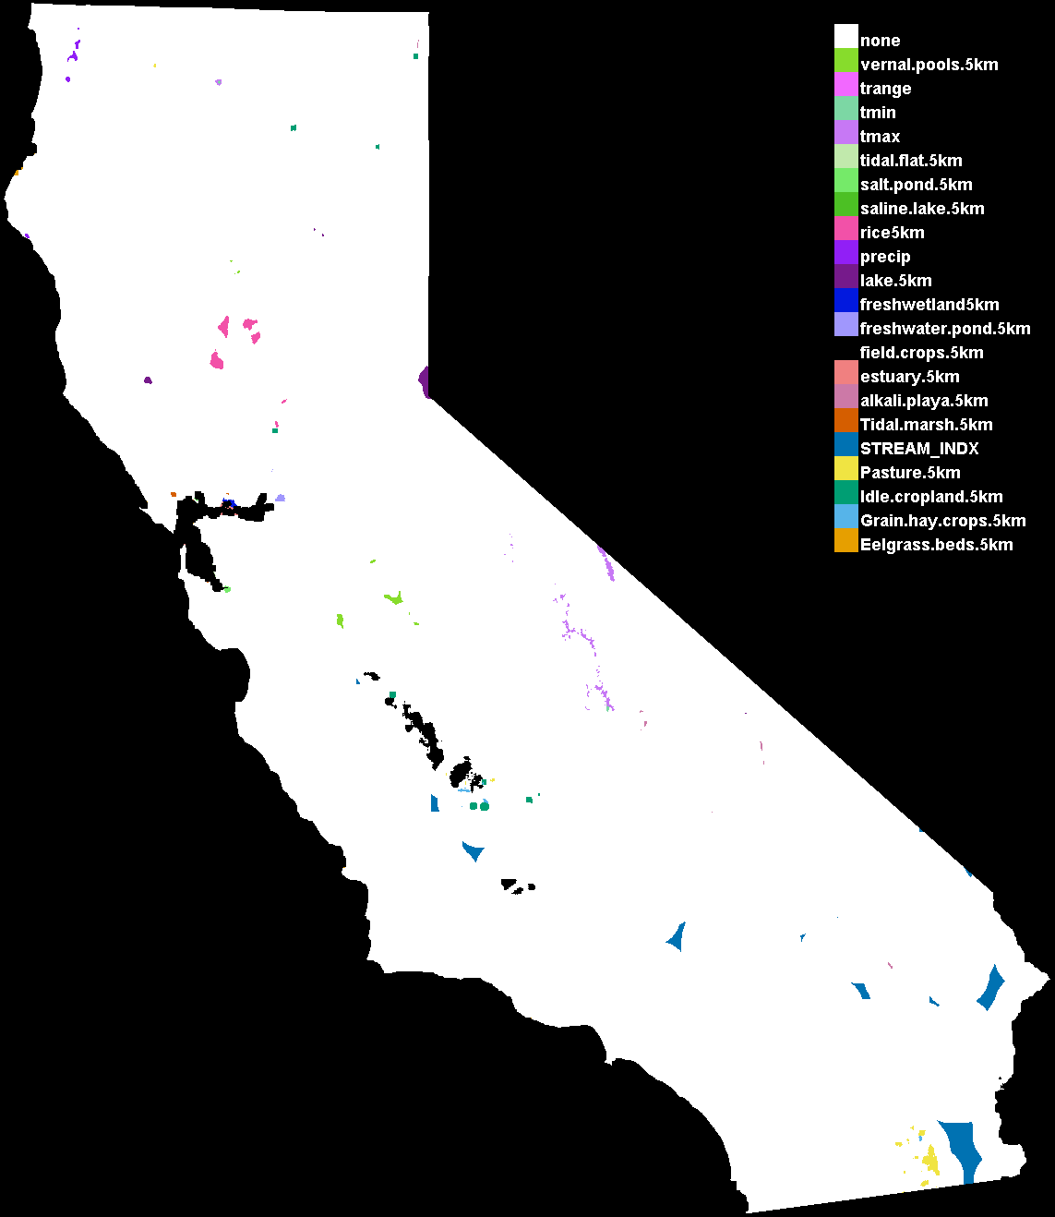
Multivariate environmental similarity surface (MESS) Maps
Novel Environments
Conditions that are outside the environmental range used to develop the model
M0del predictions into these locations should be interpreted with caution

Slide 37
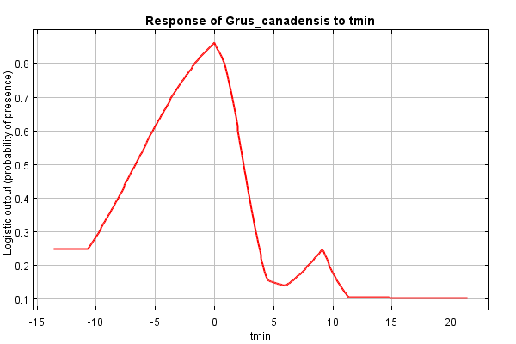
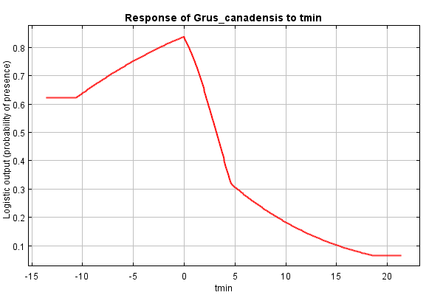
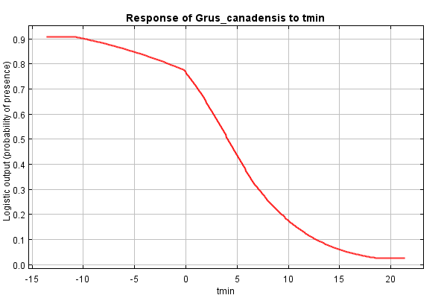
Regularization
Regularization = 0.5
Regularization = 1.o
Regularization = 2.o
Notes:
Changes in AUC – lower AUC with higher regularization value
Decreases complexity and increases transferability

Slide 38
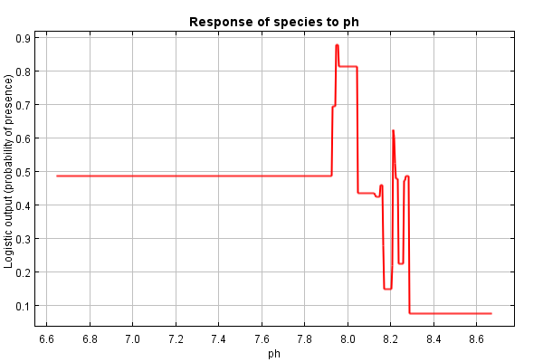
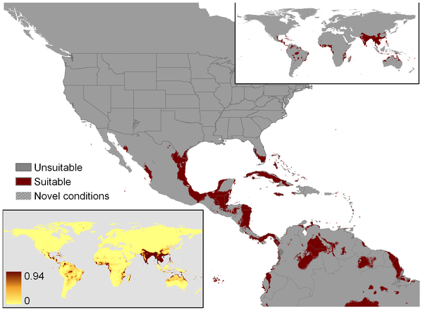
Checking for Overfitting
Test and Train AUC difference
>0.05 may be overfit
Response curves ecologically plausible?
Prediction patchy?

Slide 39
Evaluating Maxent Models and Predictions
Ecological plausibility
Threshold independent metrics
Receiver-operating characteristic (ROC) of the area under the curve (AUC)
Threshold dependent metrics
Many (Kappa, True Skill Statistic), but problems with threshold selection and background points used
Independent data set
Where are the novel areas
Checks for overfitting
Notes:
AUC: probability that a randomly chosen presence location is ranked higher than a randomly chosen background point

Slide 40
Questions to Ask
What is the source of the occurrence data?
How did you define the background? Why?
Where there any signs of overfitting?
Where are the novel areas?
If threshold used, ask why that threshold was chosen
Merow et al. (2013) provide a great guideline on the important decision that need to be made for a Maxent model

Slide 42
Settings
Output format
Logistic
0-1 values
Most common – Index of habitat suitability
Raw
All values sum to 1
Relative occurrence rate
Cumulative
Omission rate
Sum of all raw values less than or equal to the raw value at that location scaled to be between 0 -100
Notes:
Cumulative output:
if we resample pixels according to the modeled Maxent probability distribution, then t% of the resampled pixels will have cumulative value of t or less
Probability of suitable habitat given the species is present and average prevalence

