Slide 1
Valuation of California Rangeland Ecosystem Services Impacted by Climate/Land Use Change: Challenges and Opportunities
Frank Casey, Ph.D.
Science and Decisions Center
US Geological Survey
October 29, 2014
Webinar Hosted by Defenders of Wildlife and
the California Rangeland Conservation Coalition

Slide 2
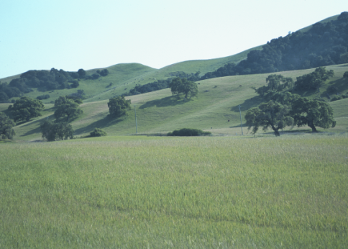
Topics
Goals
Conceptual Framework and Approach
Ecosystem Services Impacted
Directional Changes in Ecosystem Service Values
Economic Models
Challenges
Opportunities

Slide 3
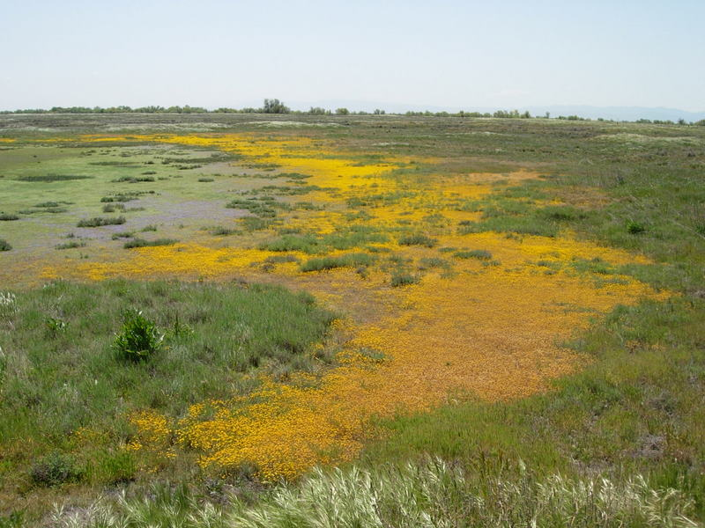
Goals
Determine impacts on regulating and supporting ecosystem services: carbon pools, water recharge/run-off, stream flows, wildlife habitat
Provisional identification of directional changes of ecosystem service values: literature review
Alameda Creek

Slide 4
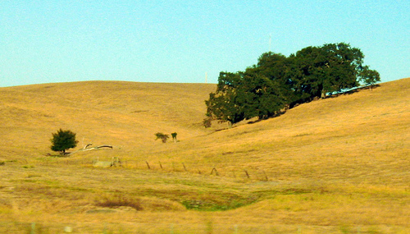
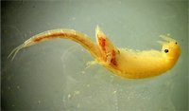

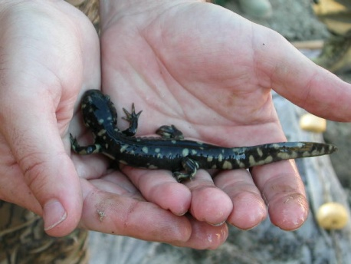
Ecosystem services provided by rangelands
Food, fiber and fuel
Wildlife habitat
Water
Carbon sequestration
Adaptation to climate change
Open space, cultural values

Slide 5
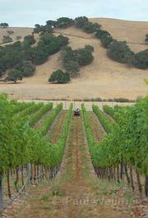
Integrated Threats to Rangelands
In California 20,000 acres of rangelands are lost every year
Privately owned
Cattle ranching: low profits
Low levels of protection
Land conversion and climate change lead to loss of grazing land, water availability, and altered species distribution

Slide 6
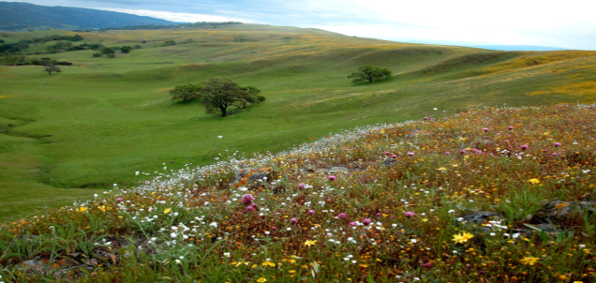
Project Scenarios
Six spatially-explicit climate change/land use change scenarios from years 2000 – 2100 consistent with three IPCC emission scenarios and two global climate models –
Assess potential threats to rangeland ecosystem services
  wildlife habitat
  water availability (Lorraine Flint and Alan Flint, USGS)
  carbon sequestration
B1 (sustainability)
1. PCM (warm, wet future)
2. GFDL CM 2.1 (hot, dry future)
A1B (wealth and technology)
1. CSIRO Mark 3.5 GCM (warm, wet future)
2. MIROC 3.2 (medres) (hot, dry future)
A2 (population pressures)
1. PCM (warm, wet future)
2. GFDL CM 2.1 (hot, dry future)

Slide 7
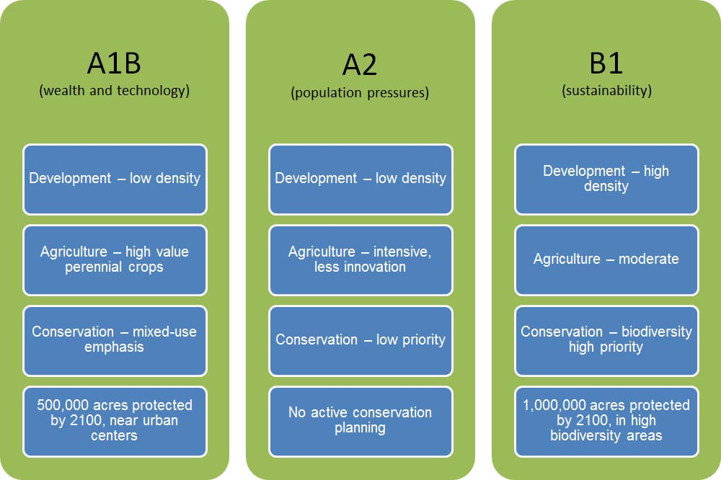
Integrated Scenarios

Slide 8
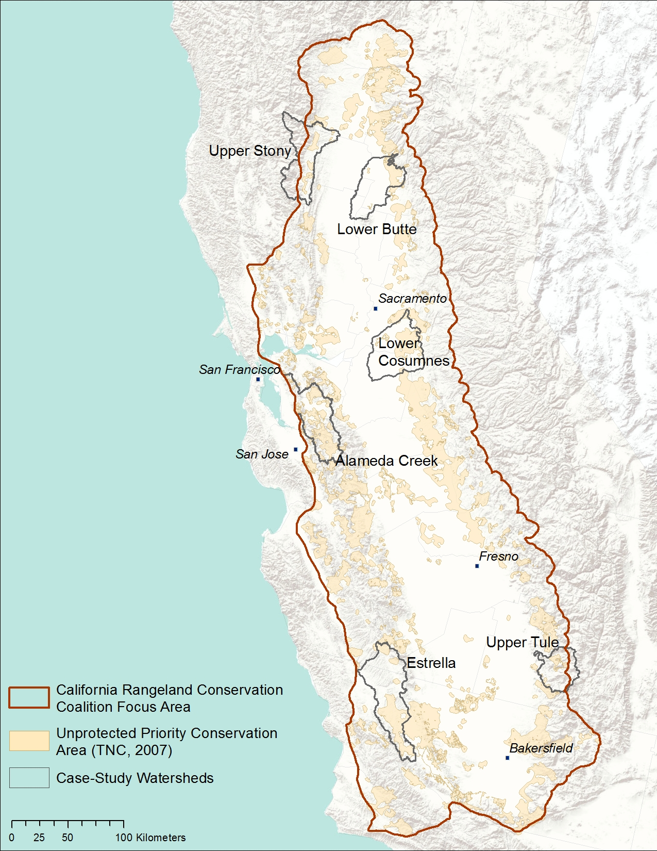
Case Study of Six Watersheds:
North:
Upper Stony
Lower Butte
Central:
Lower Cosumnes
***Alameda Creek
South:
Upper Tule
Estrella
Changes in:
Wildlife habitat
Carbon
Runoff, recharge, streamflow

Slide 9
Framework for Valuing Climate/Land Use Change Impacts
Drivers influence ecosystem functions
Ecosystem functions influence production of ecosystem services
Ecosystem services are attributed with social value
Valuations fold into objectives
Objectives potentially include resilience and sustainability
Adaptive feedback links science and management
resource
management
adaptive feedback
drivers
ecosystem
ecosystem services
valuation
goals and
objectives

Slide 10
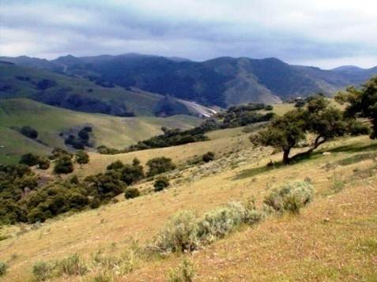
Ecosystem Functions vs. Ecosystem Services vs. Ecosystem Service Values
Ecosystem Functions:
Biophysical processes in an ecosystem
Ecosystem Services:
Outputs of ecosystem functions that directly or indirectly benefit humans
Ecosystem Service Values:
Benefits humans receive
from ecosystem service outputs
Notes:
Why does this distinction matter? Because we’re interested in protecting the value of services that are beneficial to individuals and society – it is the only value we can assign

Slide 11
What determines our economic
analysis framework
species management
habitat alteration
ecosystem restoration
infrastructure develop.
decision analysis
data assessment/display
adaptive feedback
resource
management
drivers
ecosystem
ecosystem services
valuation
goals and
objectives
climate
land use
disturbance
factors
structures
functions
processes
distribution
dynamics
scale
resilience
monitoring
goods
outputs
services
attributes
metrics
benefits
discounting
uncertainty
sustainability
ecol. condition
economic yield
risk

Slide 12
Methods for Quantifying Economic Benefits

Slide 13
Selected Benefits from California Rangeland Ecosystem Services
Benefit Ecosystem Service
Livestock harvest Forage production, water availability
Recreation-hunting, fishing Relevant species populations; land cover
Recreation-wildlife viewing Relevant species populations
Wildlife passive use benefits Relevant species populations
Drinking water provision Aquifer and surface water quality (run-off nutrient absorption)
Drinking water provision Aquifer and surface water quantity (aquifer infiltration)
Damage avoidance-Health Air quality (carbon sequestration)
Damage avoidance-Property Natural land cover, soils, wetlands (climate change, rain storm events)
Damage avoidance-Dredging Natural land cover

Slide 14
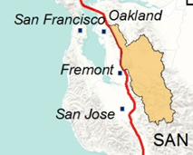
Initial Ecosystem Services Impact Analysis:
SF Bay-Alameda Creek 2006-2100
A2 and B1 similar, though loss rates are lower in B1:
  Loss of biodiversity,
  Impaired water quality.
  Less carbon sequestration,
  Less ground water storage and
  Less inputs (forage) to livestock production,
A2 GFDL (hot, dry) has more impact on wetlands, water quality and carbon sequestration than A2 PCM (warm, wet).
Notes:
Other ecosystem service impacts: fewer provisional services, increased storm water run-off due to more impervious land cover, less evapotranspiration, ground water storage compromised, decreased view shed benefits, increase greenhouse gas emissions.

Slide 15
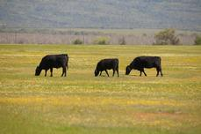
Social value of carbon : the marginal damages from carbon emissions to a society as a whole resulting from land use change and loss of grassland
Notes:
Social Cost of Carbon 2020
The methods used to estimate the SCC for the 2010-2020 time period are the same as those used for the longer 2010-2040 time frame. The difference is the average value of carbon. Again, using FIWG price estimates, the average value of the SCC is about $27.44/mt. over the 2010-2010 period. At this price level, the total SCC over the 23,350 converted grassland acres is estimated at about $10.6 million, or nearly $1 million per year. Because we did not count for annual increases in carbon stocks on remaining grasslands between 2010 and 2020, and therefore more lost carbon/acre/year on subsequently converted lands, the $10.6 SCC represents an underestimate of the true cost.
Note for 2010-2020 Time Period: Gains in Grassland Acreage for the Estrella and Upper Tule Watersheds.
Social Cost of Carbon 2040:
The avoided Social Cost of Carbon (SCC) is the social benefits from reduced atmospheric concentrations. Carbon sequestration has a social value which consists of the avoided marginal damages from carbon emissions to society, or the avoided damage done by an additional ton of carbon released into the atmosphere. Discounting is not necessary for existing SCC values because they are already expressed in terms of present value. However, the choice of which discount rate to use still needs to be made in the case of the SCC.
The Federal Interagency Working Group (2010) has estimated the SCC at 2010 prices over the period from 2010 to 2040, using the Consumer Price Index to adjust to 2010 prices over time. In this analysis, we use prices that were estimated using a social discount rate of 3% (Table A1., Federal Interagency Working Group, 2010) as it represents a “middle of the road” rate (for a summary of the literature on social discount rates used in project analyses, see Kroeger, 2009).
Although the FIWG provides annual values of the SCC, we employ an average price over the 30 year period from 2010 to 2040, estimated at about $32.6/mt. Using the amount of about 961,212 mt of SOC lost over the 30-year period due to land conversion, the total social cost of carbon released into the atmosphere is estimated to be about $31.3 million. Alternatively, one can also think of this as the benefit derived by society from not converting grasslands in the Alameda Creek watershed and maintaining carbon sequestration services.

Slide 16
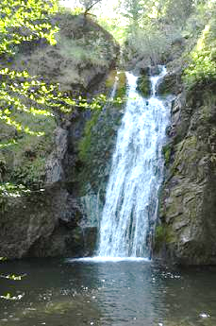
Economic Impacts of decreased groundwater recharge
Groundwater integral to sustaining types of aquatic, terrestrial and coastal ecosystem functions, but poorly understood
Hot/dry climate scenario: recharge levels would decrease 40% between 2040 and 2100 to about 95,000 m3 per year
Alameda Creek: Groundwater overdraft leads to extended periods of zero flow
Combined with overdrafts: Higher costs potentially related to reduced wildlife viewing and recreation, less wetland filtration of sediment and nutrients, more costly gray infrastructure, reduced fisheries
Notes:
For the hot/dry scenario, our modeling efforts show that while between 2010 and 2040 the decadal annual average recharge rate increases from about 110,00 m3/year to about 164,000 m3/year, but recharge levels would decrease greatly between 2040 and 2100 by about 95,000 m3 per year, or about a 40% decrease over 2040 levels. Under these conditions, in combination with continued groundwater overdraft for consumptive uses, current ecosystem functions would continue to decline. With respect to ecosystem services, riparian forests would not be as effective in providing habitat for riparian species or in cooling water temperatures, with increased economic costs of reduced wildlife viewing and other recreational opportunities. The stress on marsh ecosystems from less water would result in higher costs associated with the inability of the natural wetland infrastructure to filter sediment and nutrients, and could result in more costly gray infrastructure. Delayed or precluded salmon runs would have an adverse economic impact on recreational-related ecosystem services and those entities that directly or indirectly benefit from a healthy fishery.
An monetary estimate of the expected ecosystem service impacts from the dry-hot scenario is being worked on now. In some respects, it depends on the type of integrated water management strategies that might be adopted in dealing with lower recharge rates. For instance, possible strategies could include reservoir re-operation, water transfers, conveyance improvements, managed groundwater recharge, and recharge area protection. Each of these interventions would result in different cost structures and potential secondary benefits.

Slide 17
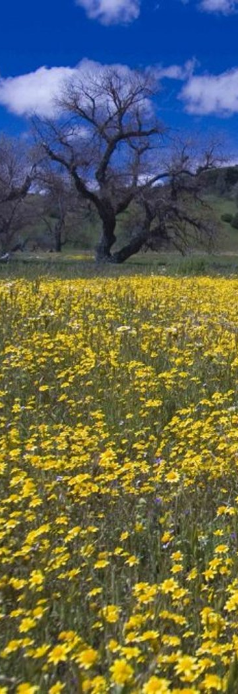
Economic Impacts of decreased groundwater recharge (con’t)
Reduced capacity by riparian forests to provide habitat and cooling water temperature impacts wildlife viewing, fishing and water based recreation;
Precluded restoration of salmon and trout runs
Stress on marsh ecosystems and inability of natural infrastructure to filter sediment and nutrients: could result in more costly gray infrastructure.
Agricultural example: rise in total water supply operating costs of $490 million/year by 2050 (Medellin-Azuara et al 2008).
Notes:
For the hot/dry scenario, our modeling efforts show that while between 2010 and 2040 the decadal annual average recharge rate increases from about 110,00 m3/year to about 164,000 m3/year, but recharge levels would decrease greatly between 2040 and 2100 by about 95,000 m3 per year, or about a 40% decrease over 2040 levels. Under these conditions, in combination with continued groundwater overdraft for consumptive uses, current ecosystem functions would continue to decline. With respect to ecosystem services, riparian forests would not be as effective in providing habitat for riparian species or in cooling water temperatures, with increased economic costs of reduced wildlife viewing and other recreational opportunities. The stress on marsh ecosystems from less water would result in higher costs associated with the inability of the natural wetland infrastructure to filter sediment and nutrients, and could result in more costly gray infrastructure. Delayed or precluded salmon runs would have an adverse economic impact on recreational-related ecosystem services and those entities that directly or indirectly benefit from a healthy fishery.
An monetary estimate of the expected ecosystem service impacts from the dry-hot scenario is being worked on now. In some respects, it depends on the type of integrated water management strategies that might be adopted in dealing with lower recharge rates. For instance, possible strategies could include reservoir re-operation, water transfers, conveyance improvements, managed groundwater recharge, and recharge area protection. Each of these interventions would result in different cost structures and potential secondary benefits.

Slide 18
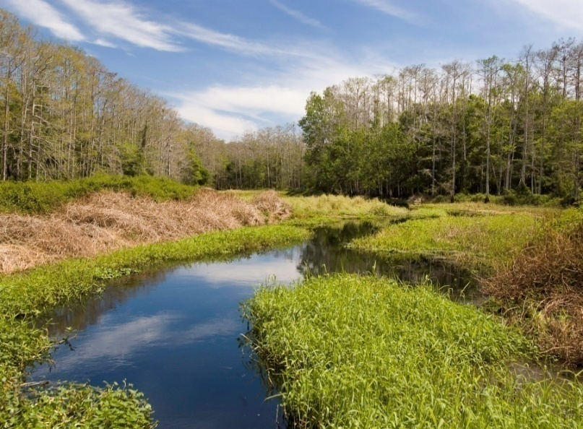
Wildlife Habitat/Species Valuation
Rangeland habitat for freshwater fish, wintering birds, pollinators, invertebrates and mammals (75 listed under the ESA).
Existence values; recreational uses; production benefits; aesthetic values
Freshwater fishing: Estimated $64-$267/person/day
Fishing licenses: $1.8 million 2012
Wetland habitats: $625-$261 acre/year
Vernal pool habitat: $30/person/year
Wildlife viewing: $80-$48/person/day
Hunting: 22,000 Alameda licenses
Notes:
18

Slide 19
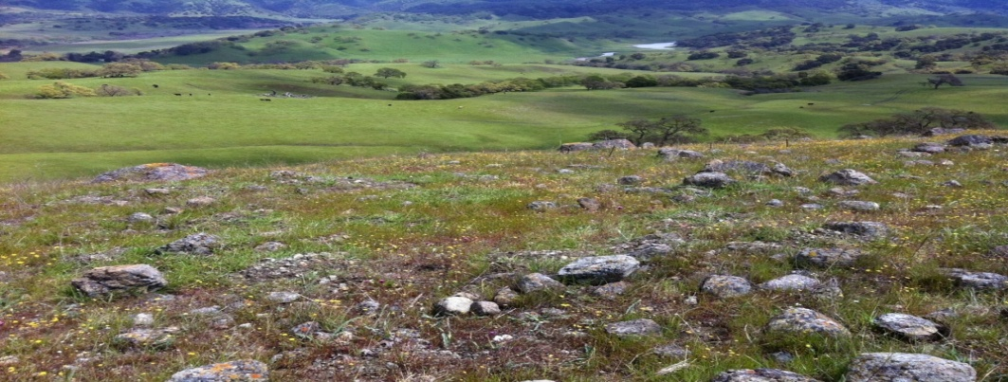
Challenges of Valuing Ecosystem Services
Geographic and Time scales
Lack of site specific primary and secondary studies (existence/habitat)
Baseline water infrastructure cost to provide monetary impacts of reduced recharge/increase run-off
Complete economic analysis will depend on water management strategies adopted (reservoir reoperation, water transfers, recharge protection, etc.)
Notes:
19

Slide 20
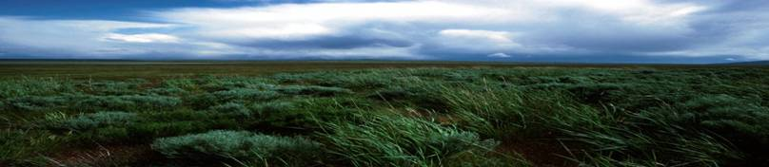
Challenges with Valuing Costs and Benefits
Lack of research on baselines and changes in rangeland ecosystem service values: soil retention, nutrient recycling, run-off control, groundwater recharge and wildlife species, water quality improvement, compromised view sheds, pollination capacity
Remember: valuing marginal changes

Slide 21
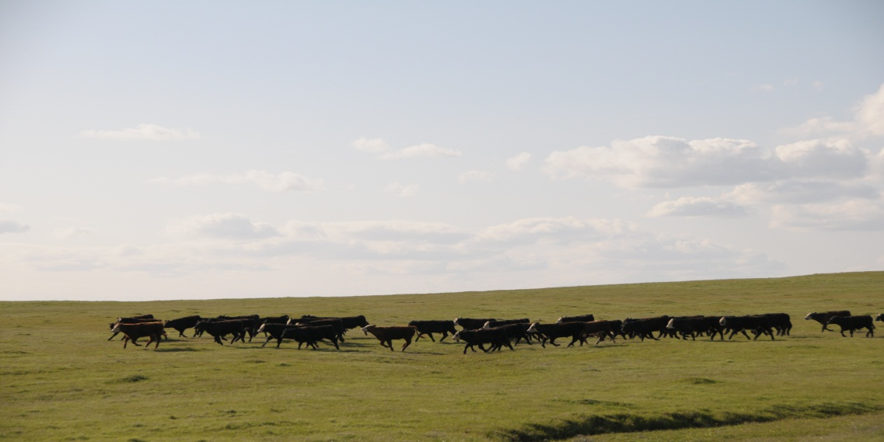
Opportunities and Recommendations
Wildlife and Habitat: Apply the Habitat Benefits Tool Box or other Socio-Economic model
Basic ecological and economic research on rangeland ecosystem services impacted by changes in run-off and recharge
Basic research on climate change
impacts on rangeland functions and
productivity (done for crop agriculture,
but not rangelands).
Notes:
21

Slide 22
Opportunities and Recommendations
Commission studies to understand the implications of climate change for flood, aquifer storage and water quality management on rangelands
Develop a case study to compare the ecosystem service and economic impacts of climate change under different water management strategies: reservoir reoperation, water transfers, etc.
Additional research on rangeland amenity values (oak woodlands, >$2,000/acre (Oviedo, et al 2012).
Notes:
22

Slide 23
Opportunities and Recommendations
Increase research and information related to the diversity, abundance, and location of ground-water dependent ecosystems (Howard and Merrifield, 2010).
Up-date and conduct surveys to value both use and non-use values of wildlife habitat, species, and other ecosystem services (Willingness to Pay; Contingent Valuation, Public Participation).
Determine impacts of climate change on water delivery system management costs and consumer prices
Notes:
23

Slide 24
Socio-Economic Valuation Tools
Ecosystem Service Markets: Negotiations between buyers and sellers-water quality, CAR, habitat banking
Artificial Intelligence for Ecosystem Services (ARIES)
Integrated Valuation of Ecosystem Services and Trade-offs (InVest)
Habitat Benefits Toolbox: Habitats, Water, Open Space (Benefit Transfer).
Social Values for Ecosystem Services (SolVES)

Slide 25
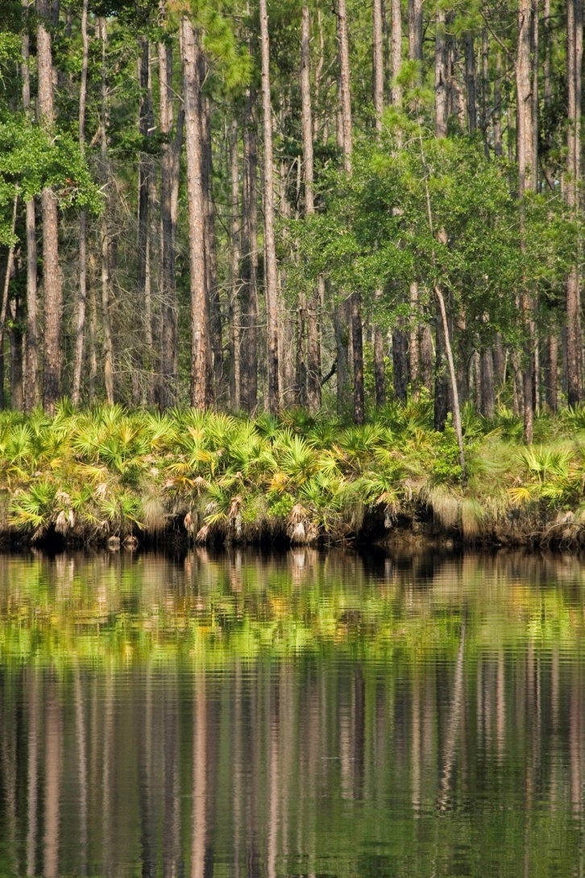
Uses of the Benefits Toolbox
Quantify the potential gains/losses from land conversion
Compare value of alternative restoration and management practices
Identify conservation sites that generate the highest value per $

Slide 26
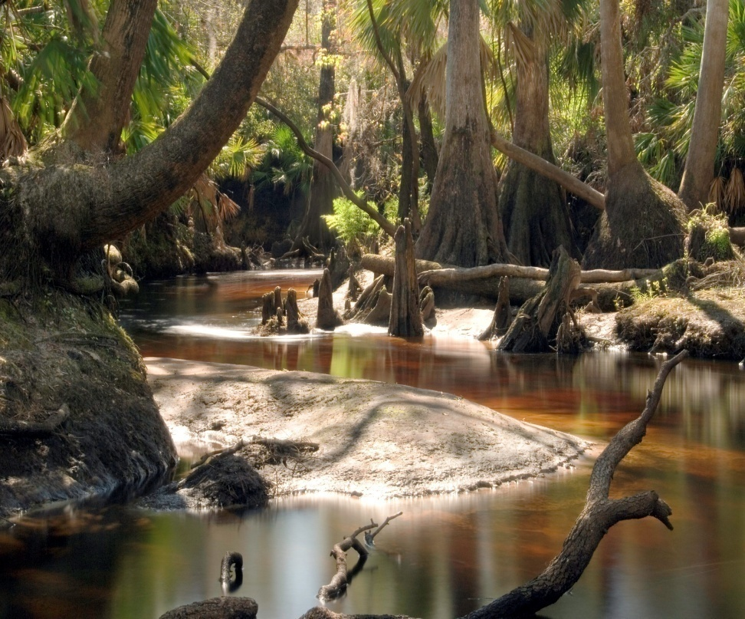
Uses of the Habitat Benefits Toolbox
Quantify the public value of a conservation area (recreation; ecosystem service values; property value premiums) to:
-Strengthen the case for public cost-share
-Request increased public funds for research and conservation

Slide 27
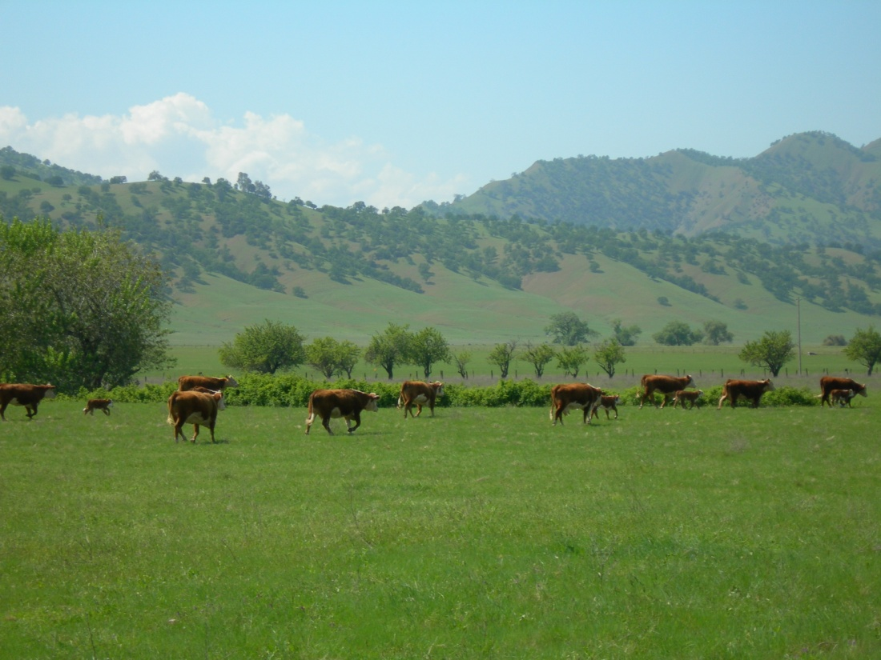
Payment for Ecosystem Services
Very little familiarity with terms Ecosystem Services or Payments for Ecosystem Services (PES). BUT
  Familiar with terms such as wildlife habitat management, water quality improvement, vegetation management, invasive species control
Interested in participating in PES programs: 77% Yes; and favor creation of PES programs
PES contract length, payment level, and administrator all equally and very important to participation decision

Slide 28
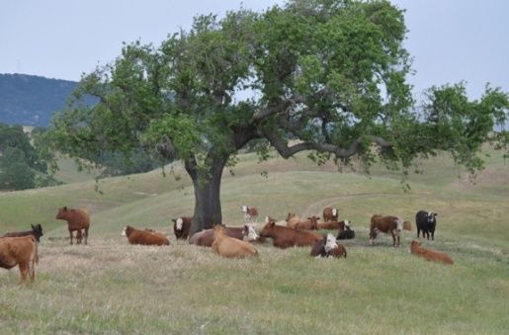
Rancher’s Preferences
Shorter contracts and higher payment levels
  Each additional year valued at $.71/acre ($21.30 for 30 years)
  Increased payments increase likelihood of participation
Program Administration
  Conservation Organization
  Federal Government/Private Company
    $6.60/acre / $3.25/acre
  State Agency: $20.96/acre

Slide 29
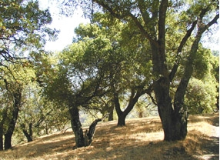
Frank Casey - ccasey@usgs.gov
Science and Decisions Center
US Geological Survey
Notes:
29

Slide 30
Acknowledgements
Kristin Byrd, USGs Western Geographic Center
Lorraine and Alan Flint, California Water Center
Pelayo Alvarez, California Rangeland Conservation Coalition

